Slide 1
INVERSE PROBLEM FOR RADIATIVE TRANSFER APPLIED TO MEDICAL TOMOGRAPHY
Desmond Roussel Ngueguin
Under the supervision of:
Emmanuel Franck
Laurent Navoret
Vincent Vigon
For the teaching unit: “Projet”
Overseen by Christophe Prud'homme
May 28, 2020
Notes:
- Mettre une version raccourcie de l’algorithme
- Mettre le fichier de configuration

Slide 2
CONTENT
CONTEXT
DESCRIPTION
ROADMAP
Mathematical basis
Solving the model
RESULTS
Test cases
Data analysis
MILESTONES
CHALLENGES
PERSPECTIVES
REFERENCES

Slide 3
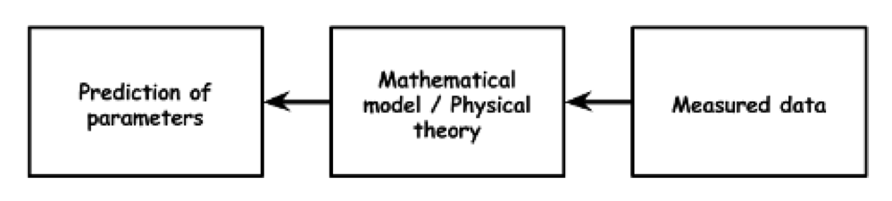
CONTEXT
Proposed by the MOCO Team at IRMA
Inverse problems encountered in:
medical imaging
computer vision
radar, etc.
They are hard to solve, that's why we will be introducing a machine learning approach.
Figure 1: Inverse problem (Subramaniyam, 2018)

Slide 4
DESCRIPTION
Objectives
Solve the forward problem for thermal radiation
Get ready for AI prediction using neural networks
We send an infrared light beam through an organ and we measure the signal on part of that organ. Knowing the initial conditions and the signal at all times, we can infer the influence of the organ’s optical properties.
Tasks
Read about the mathematical model to be used
Implement the numerical scheme using the finite volumes method
Run test cases
Analyze the data
Write the reports
Present the work that was done
Figure 2: Near-infrared spectroscopy (Nakagawa et al., 2017)
Notes:
Spectroscopy is the study of the interaction between matter and electromagnetic radiation.

Slide 5
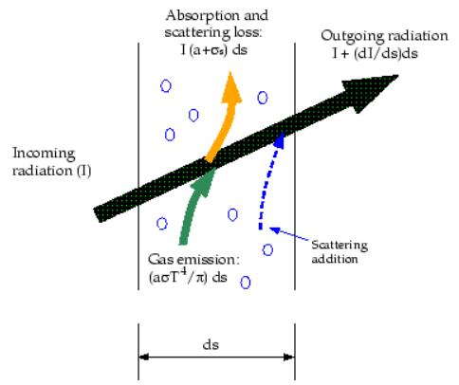
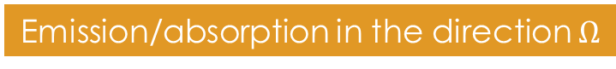
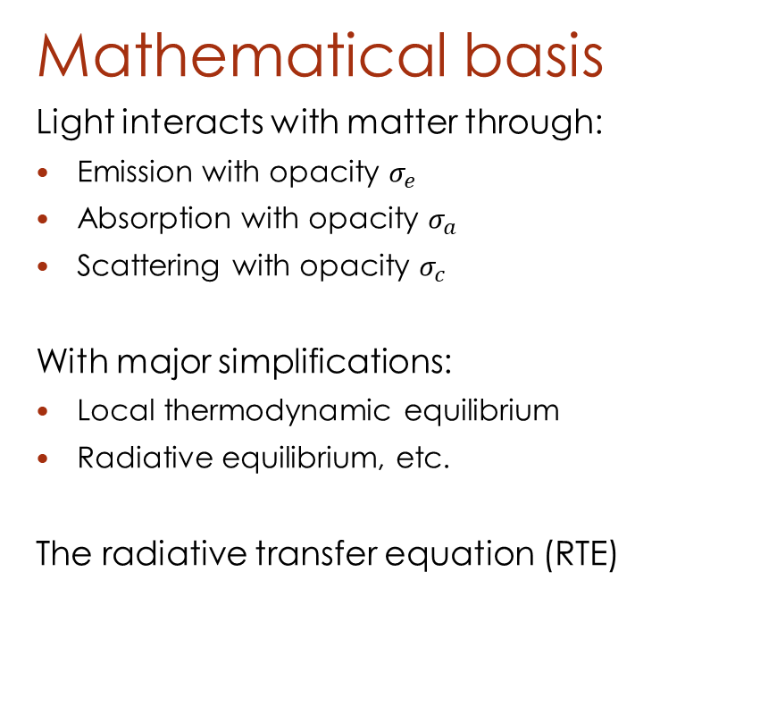
ROADMAP
Mathematical basis
Light interacts with matter through:
Emission with opacity $σ_{e}$
Absorption with opacity $σ_{a}$
Scattering with opacity $σ_{c}$
With major simplifications:
Local thermodynamic equilibrium
Radiative equilibrium, etc.
The radiative transfer equation (RTE)
Figure 3: Radiative transfer phenomenon in a gas (Ansys Fluent, n.d)
Emission/absorption in the direction $Ω$
Gain/loss due to scattering
Notes:
The RTE is very trivial to understand but quite difficult to solve.

Slide 6
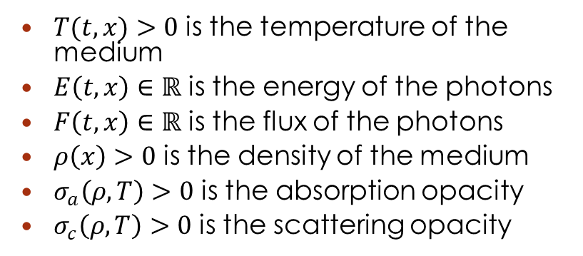
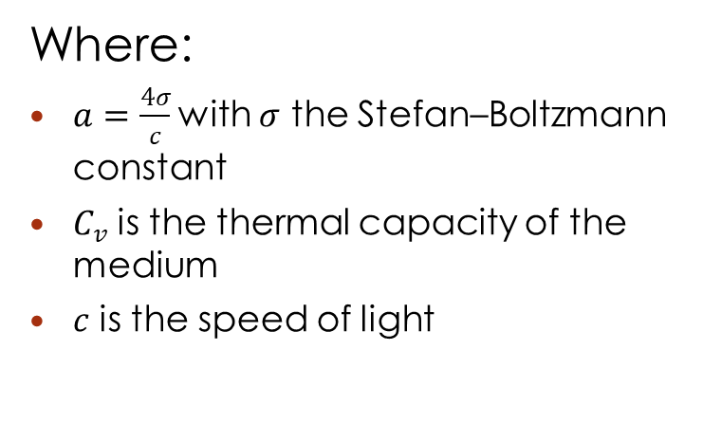
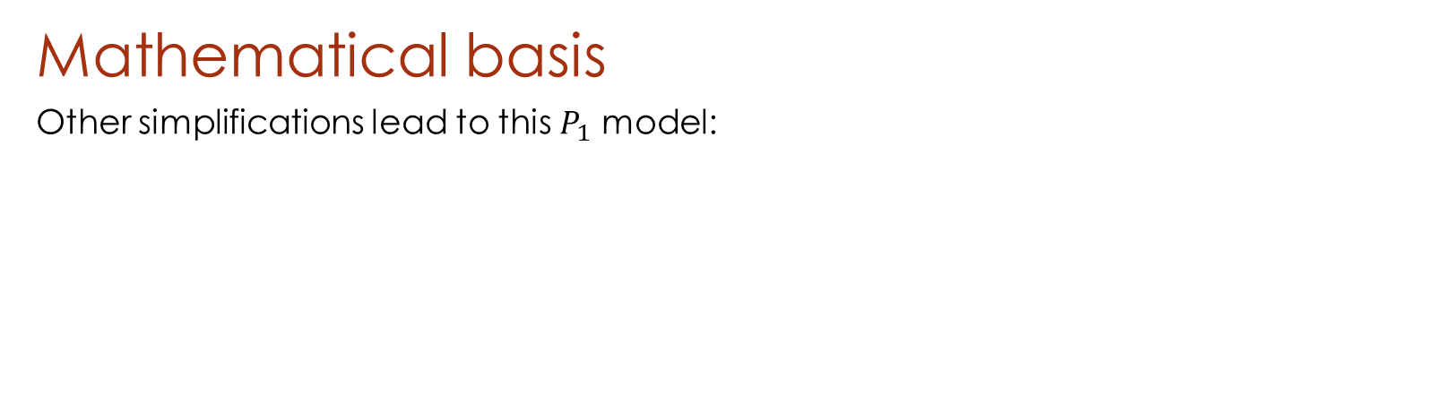
ROADMAP
Mathematical basis
Other simplifications lead to this $P_{1}$ model:
Where:
$a=\frac{4σ}{c}$with $σ$ the Stefan–Boltzmann constant
$C_{v}$ is the thermal capacity of the medium
$c$ is the speed of light
$T(t, x)>0$ is the temperature of the medium
$E\left(t, x\right)∈ℝ$ is the energy of the photons
$F\left(t, x\right)∈ℝ$ is the flux of the photons
$ρ\left(x\right)>0$ is the density of the medium
$σ_{a}\left(ρ, T\right)>0$ is the absorption opacity
$σ_{c}\left(ρ, T\right)>0$ is the scattering opacity
Notes:
This model is not exactly the P1 model as defined in the litterature. the sigma_𝑐 should be sigma_a + sigma_c
This lead to some problems. More about that in the conclusion.

Slide 7
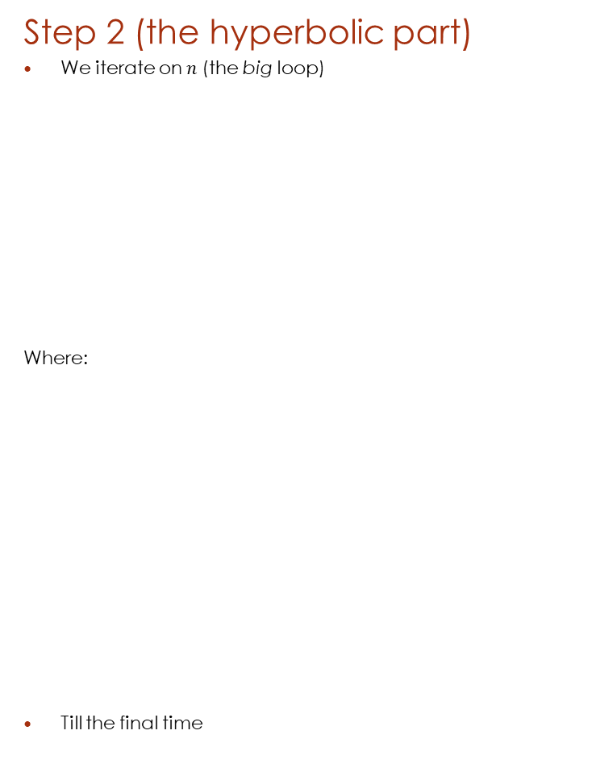
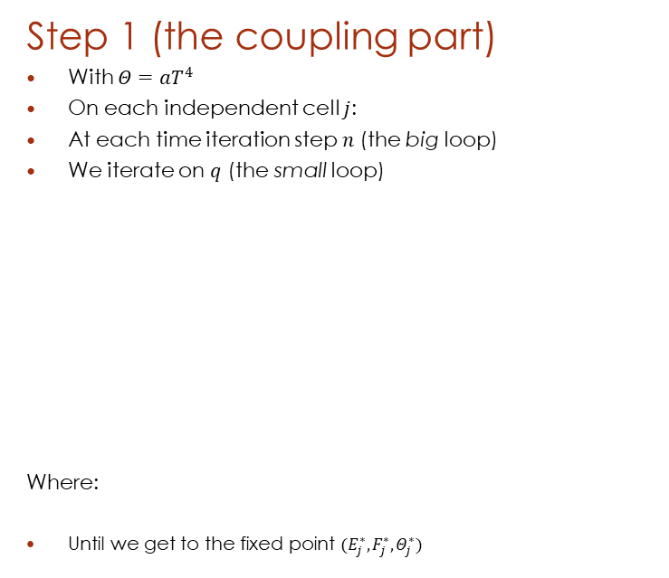
ROADMAP
Step 2 (the hyperbolic part)
We iterate on$n$ (the big loop)
Where:
Till the final time
Solving the problem
Using the finite volumes method
Using a “splitting” scheme
CFL condition for stability:
Step 1 (the coupling part)
With $Θ=aT^{4}$
On each independent cell $j$:
At each time iteration step $n$ (the big loop)
We iterate on $q$ (the small loop)
Where:
Until we get to the fixed point $(E_{j}^{∗}, F_{j}^{∗}, Θ_{j}^{∗})$

Slide 8
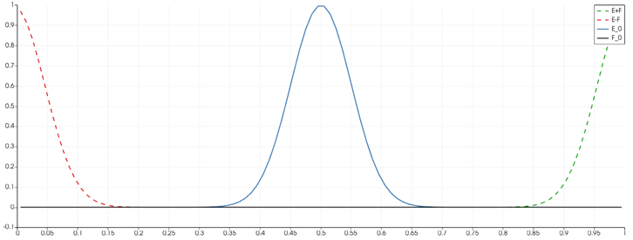
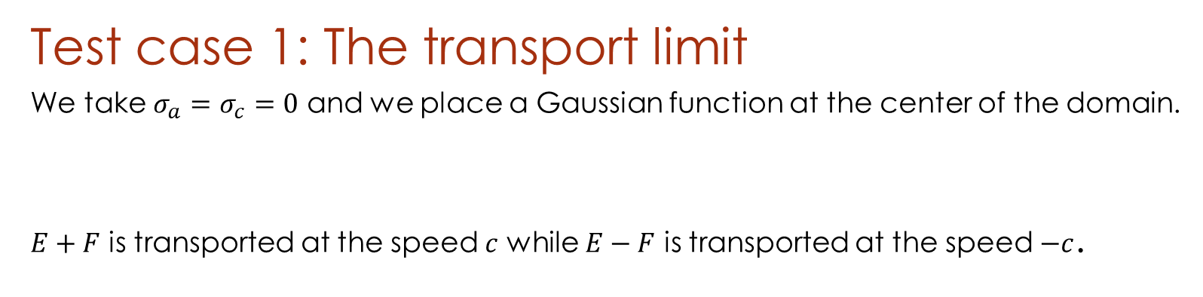
RESULTS
Test case 1: The transport limit
We take $σ_{a}=σ_{c}=0$ and we place a Gaussian function at the center of the domain.
$E+F$ is transported at the speed $c$ while $E−F$ is transported at the speed $−c$.
Figure 4: Transport limit with speed c=1
Notes:
Remember to remove the 1/3 in the P1 model on slide 6
other parameters are defined in carefully designed configuration files in the Github repository

Slide 9
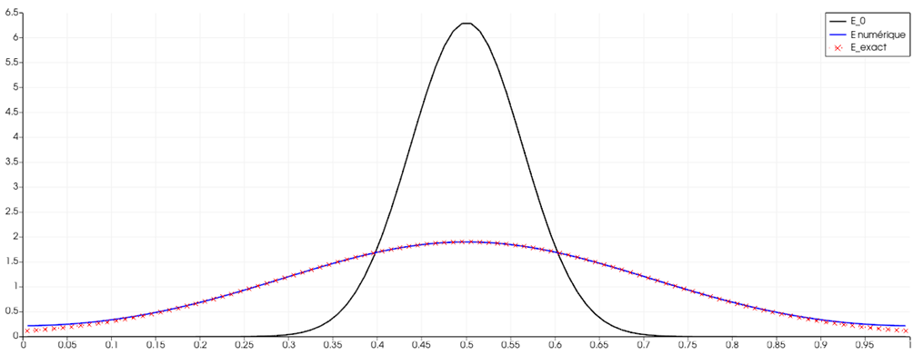
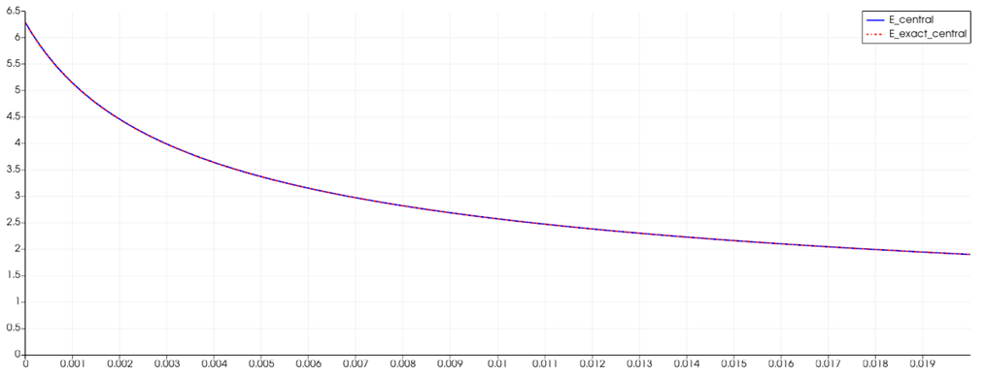
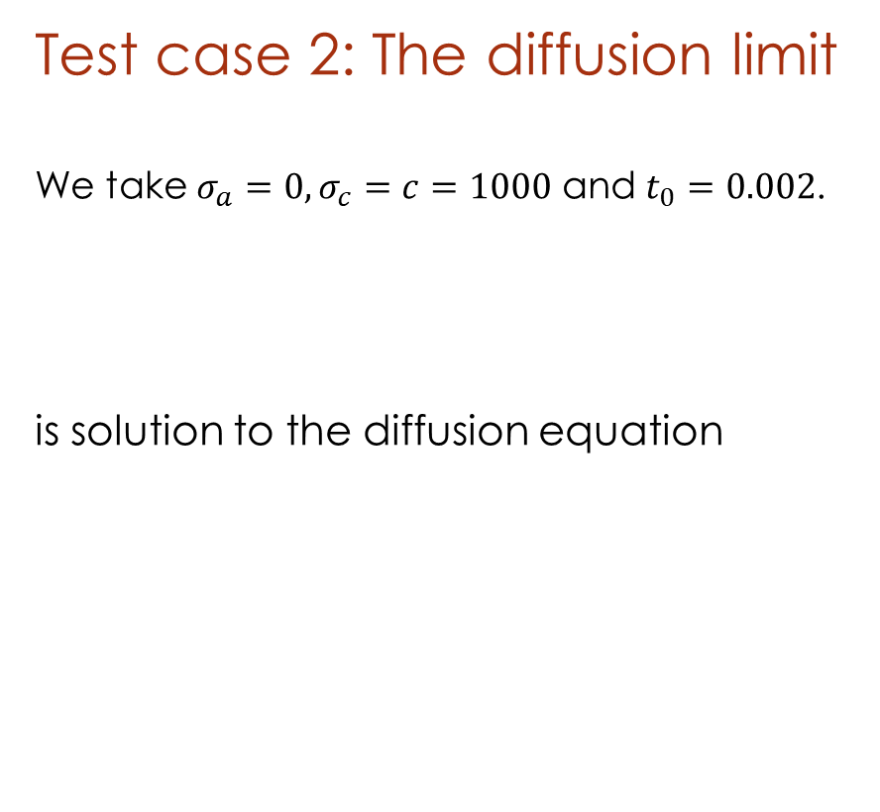
RESULTS
Test case 2: The diffusion limit
We take $σ_{a}=0,σ_{c}=c=1000$ and $t_{0}=0.002$.
is solution to the diffusion equation
Figure 5: Spatial visualization for the diffusion limit
Figure 6: Temporal decrease in energy at the center of the domain for the diffusion limit
Notes:
Once again, remember to remove the 1/3 in the P1 model

Slide 10
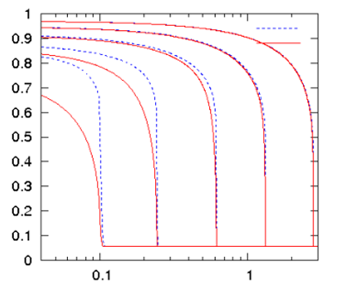
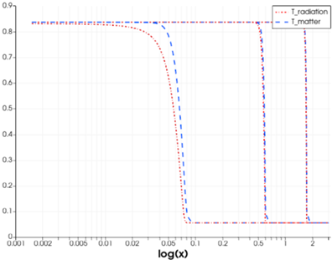
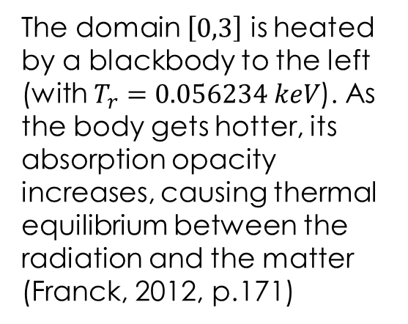
RESULTS
Test case 3: Olson-Auer-Hall
The domain $\left[0,3\right]$ is heated by a blackbody to the left (with $T_{r}=0.056234 keV$). As the body gets hotter, its absorption opacity increases, causing thermal equilibrium between the radiation and the matter (Franck, 2012, p.171)
Figure 7: Expected results for t=1/c, 3/c, 10/c, 30/c, and 100/c (Franck, 2012, p.171)
Figure 8: Obtained results for t=0.1/c, 1/c, and 3/c
Notes:
The reason this case does not work might be because we are not solving the same P1 model. On slide 6, remember to replace sigma_c with sigma_a + sigma_c

Slide 11
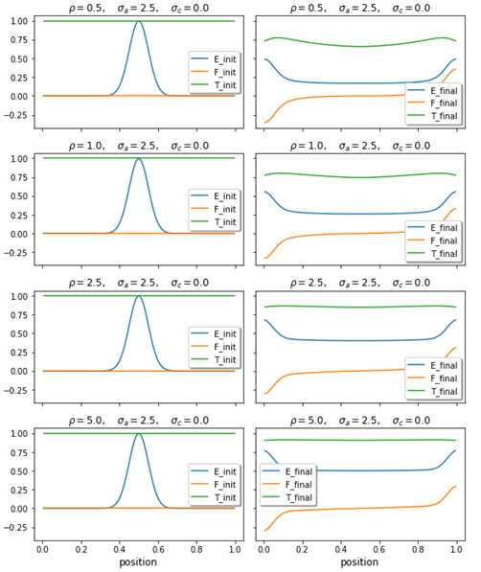
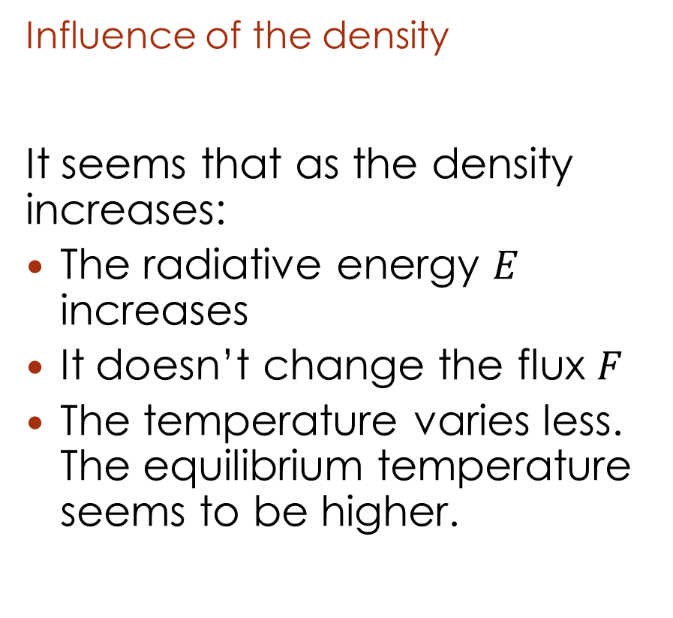
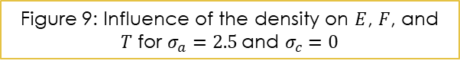
RESULTS
Influence of the density
It seems that as the density increases:
The radiative energy $E$ increases
It doesn’t change the flux $F$
The temperature varies less. The equilibrium temperature seems to be higher.
Figure 9: Influence of the density on $E$, $F$, and $T$ for $σ_{a}=2.5$and $σ_{c}=0$

Slide 12
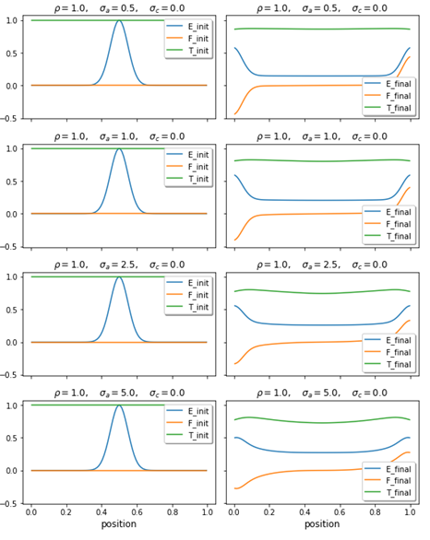
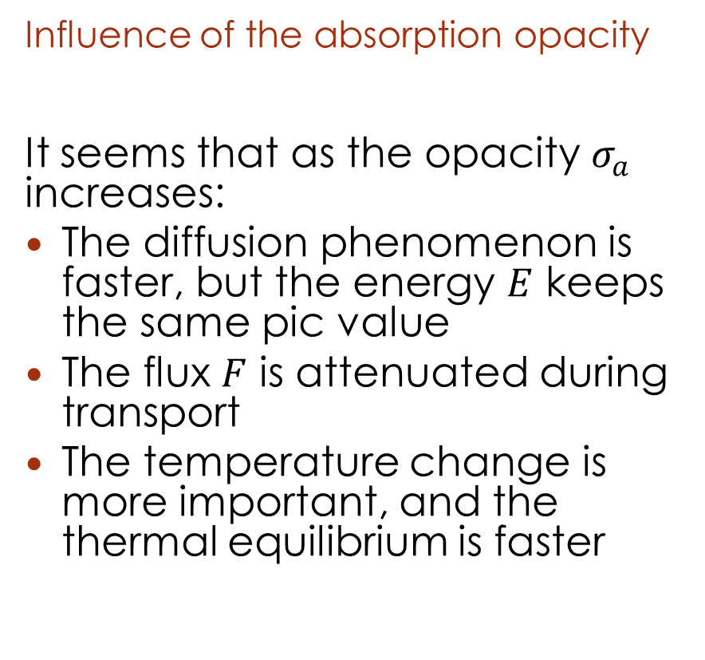
RESULTS
Influence of the absorption opacity
It seems that as the opacity $σ_{a}$ increases:
The diffusion phenomenon is faster, but the energy $E$ keeps the same pic value
The flux $F$ is attenuated during transport
The temperature change is more important, and the thermal equilibrium is faster
Figure 10: Influence of $σ_{a}$ for $ρ=1$ and $σ_{c}=0$

Slide 13
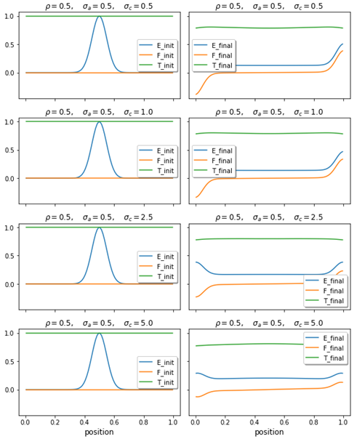
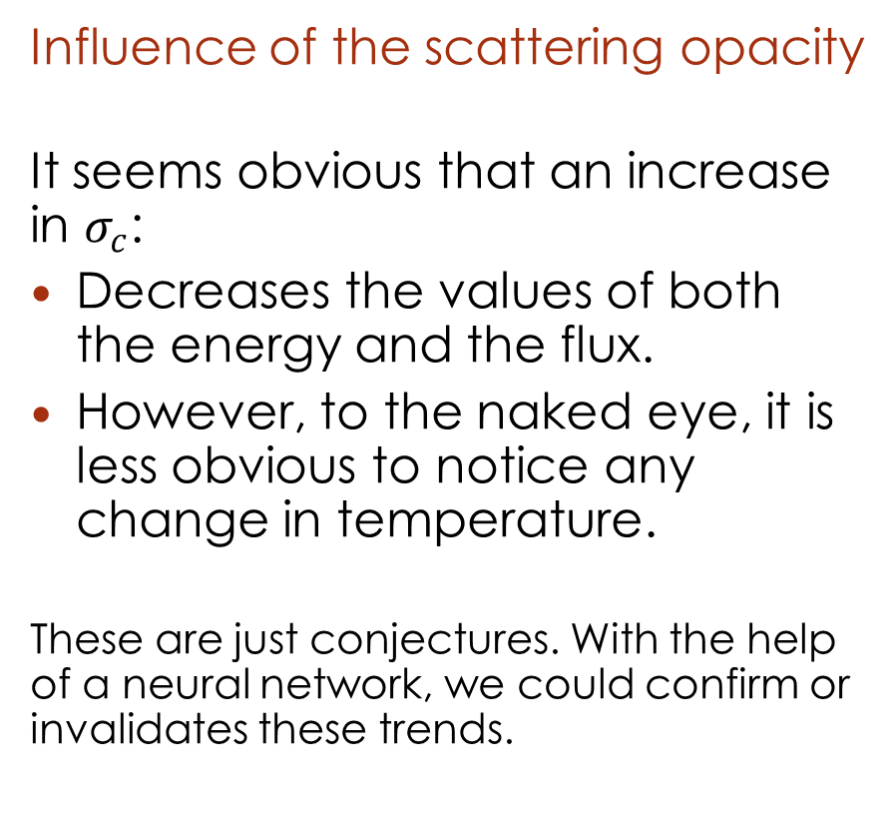
RESULTS
Influence of the scattering opacity
It seems obvious that an increase in $σ_{c}$:
Decreases the values of both the energy and the flux.
However, to the naked eye, it is less obvious to notice any change in temperature.
These are just conjectures. With the help of a neural network, we could confirm or invalidates these trends.
Figure 11: Influence of $σ_{c}$ for $ρ=0.5$ and $σ_{a}=0.5$
Notes:
This stuff is easily discovered by a CNN

Slide 14
MILESTONES

Slide 15
CHALLENGES
Notations and nomenclature (stellar atmosphere in astrophysics, nuclear fusion by inertial confinement, etc…)
Performance in the C++ implementation of the scheme
Notes:
As discussed before, even when a P1 model was found, it didn't exactly match what we wanted. That's why we do not have a lot of test cases.

Slide 16
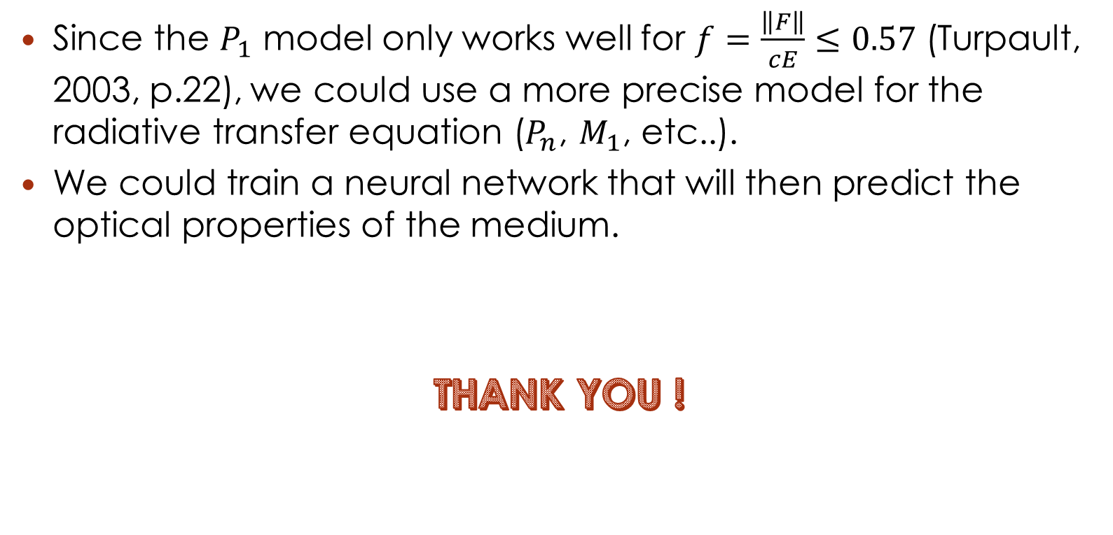
PERSPECTIVES
Since the $P_{1}$ model only works well for $f=\frac{\left\|F\right\|}{cE}≤0.57$ (Turpault, 2003, p.22), we could use a more precise model for the radiative transfer equation ($P_{n}$, $M_{1}$, etc..).
We could train a neural network that will then predict the optical properties of the medium.
THANK YOU !
Notes:
Lamination du flux == stacking factor

Slide 17
REFERENCES
Subramaniyam, P. (2018). “The Inverse Problem in EEG – Assumptions and Pitfalls”. Retrieved from https://sapienlabs.org/the-inverse-problem-in-eeg/
Franck, E. October 23, 2012. “Construction et analyse numérique de schéma asymptotic preserving sur maillages non structurés. Application au transport linéaire et aux systèmes de Friedrichs”. Retrieved from https://tel.archives-ouvertes.fr/file/index/docid/744371/filename/theseFranckv3.pdf
Nakagawa, I. et al., (2017). “Indocyanine green kinetics with near-infrared spectroscopy predicts cerebral hyperperfusion syndrome after carotid artery stenting”. Retrieved from https://journals.plos.org/plosone/article/figure?id=10.1371/journal.pone.0180684.g002
Ansys Fluent. (n.d). “Radiative Transfer Equation”. Retrieved from https://www.afs.enea.it/project/neptunius/docs/fluent/html/th/node111.htm
Turpault, R. (2003). "Modelisation, approximation numerique et applications du transfert radiatif en desequilibre spectral couple avec l’hydrodynamique". Mathématiques [math]. Université Sciences et Technologies - Bordeaux I, 2003. Français. tel-00004620

